Slide 1

Yelp Dataset Challenge
Group 2

Slide 2
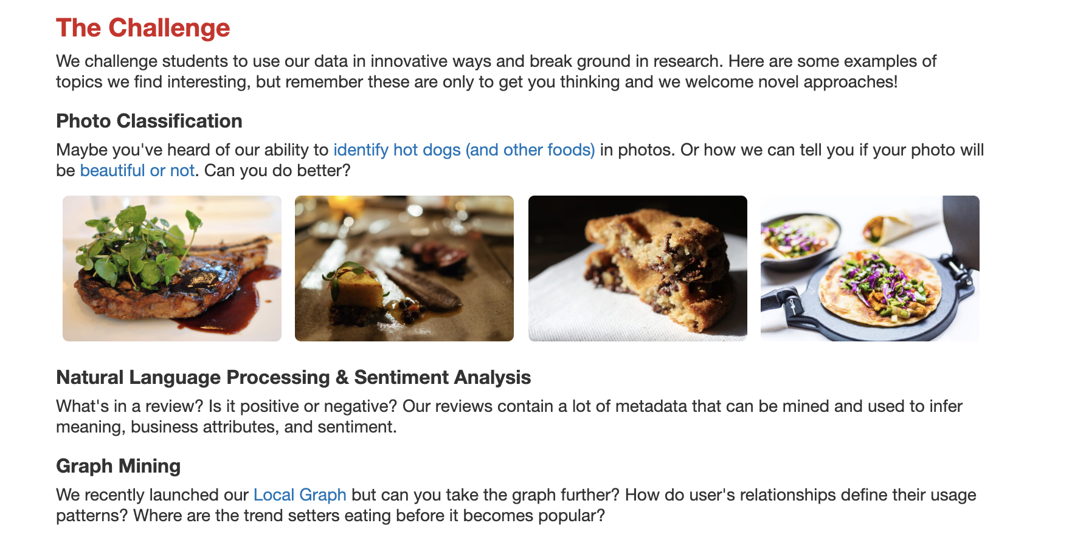
What is the yelp dataset challenge?
It challenges students to use yelp’s data and conduct research and analysis.
It challenges students to use data in innovative ways to break ground in research and the chance to win prizes.
It challenges students to use data on behalf of any third party with Yelp’s consent.
It challenges students to use the data in connection with any commercial purpose.
Example of previous tasks
Notes:
(ORIGINAL) SLIDE: What is the yelp dataset challenge?

Slide 3
What is the yelp dataset challenge?
Challenges students to:
Use Yelp’s data and conduct research and analysis.
Use data on behalf of any third party with Yelp’s consent.
Use data in connection with any commercial purpose.
Encourages:
Innovation and the chance to win prizes.
Exploration in applied data science.
Practical use of data to solve real-world problems.
Notes:
(REVISED) SLIDE: What is the yelp dataset challenge?

Slide 4
Example of Previous Tasks
Notes:
(REVISED) SLIDE: What is the yelp dataset challenge?

Slide 5
What are we going to do with this dataset?
Main Priority: We will try to make recommendations for user’s of where to eat based on historical data for restaurants a user went to.
Features that we will take into consideration for right now:
Categories of restaurants user has visited
# of stars a user has given to restaurants visited
Review was useful
After more through feature engineering, we will then decide what other features are important
Second Task: Doing a sentiment anaylsis, we will also the perform the task of building a text classifier to determine whether a user liked a restaurant they visited in the past or not, via their reviews.
Notes:
(ORIGINAL) SLIDE: What are we going to do with this dataset?

Slide 6
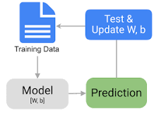
Tasks we will be performing:
Data Collection ✓
Data Preparation
Choose a Model
Train the Model
Evaluate the Model
Hyperparameter tuning
Make predictions
Deploy
Discuss Plan for future Maintenance and how we can get real time predictions (things like Kafka)
What is Kafka?
Distributed publish-subscribe messaging system that receives from disparate source systems and make the data available to target systems in real time

Slide 7
If we have time, tasks that we will explore:
We will convert the recommendation engine into a flask api and deploy it via heroku
We will create a word cloud looking at the business id and review to find what are the categories associated with that restaurant. (This would be a good visualization tool for future projects)
Look more in depth at reviews and picking the top 5 cuisines in the dataset and see what concerns the customer and what makes a good restaurant (Application help with growth and profit)
Computer Vision ( Trying to extract image features that represent restaurant use a classification algorithm to classify restaurant)

Slide 8
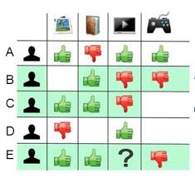
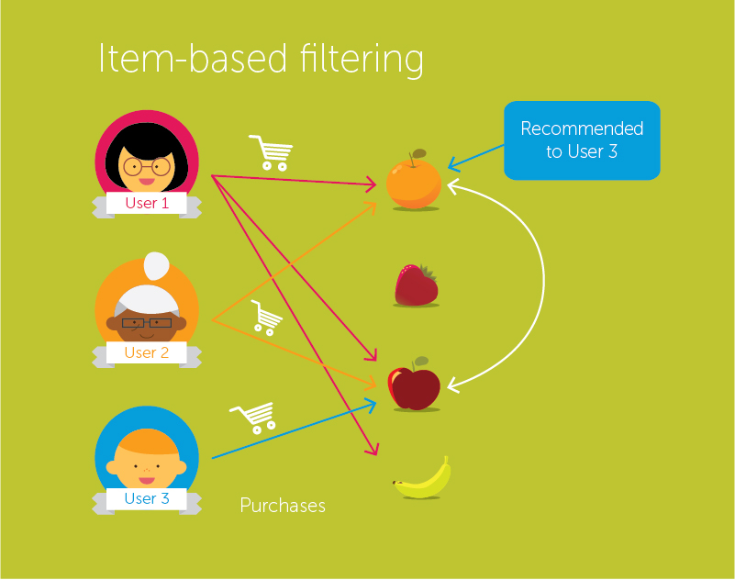
Prototype Demo: Recommendation Engine Yelp
It is a form of collaborative filtering for recommender systems based on the similarity between items calculated using people’s ratings of those items

Slide 9
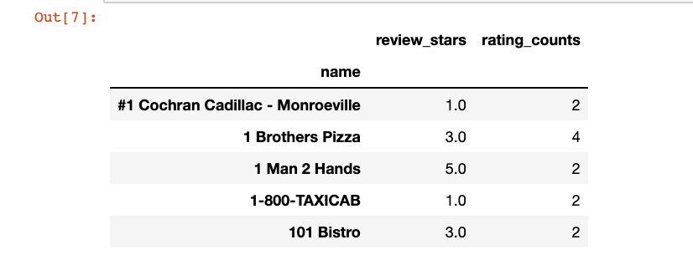
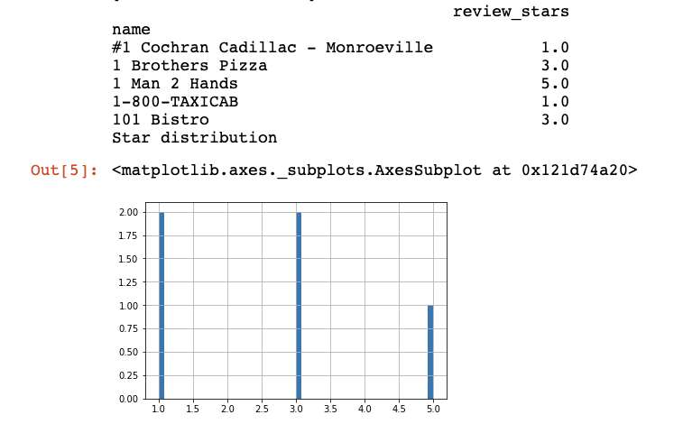
Recommendation Engine Yelp Prototype
Most ratings are a 3

Slide 10
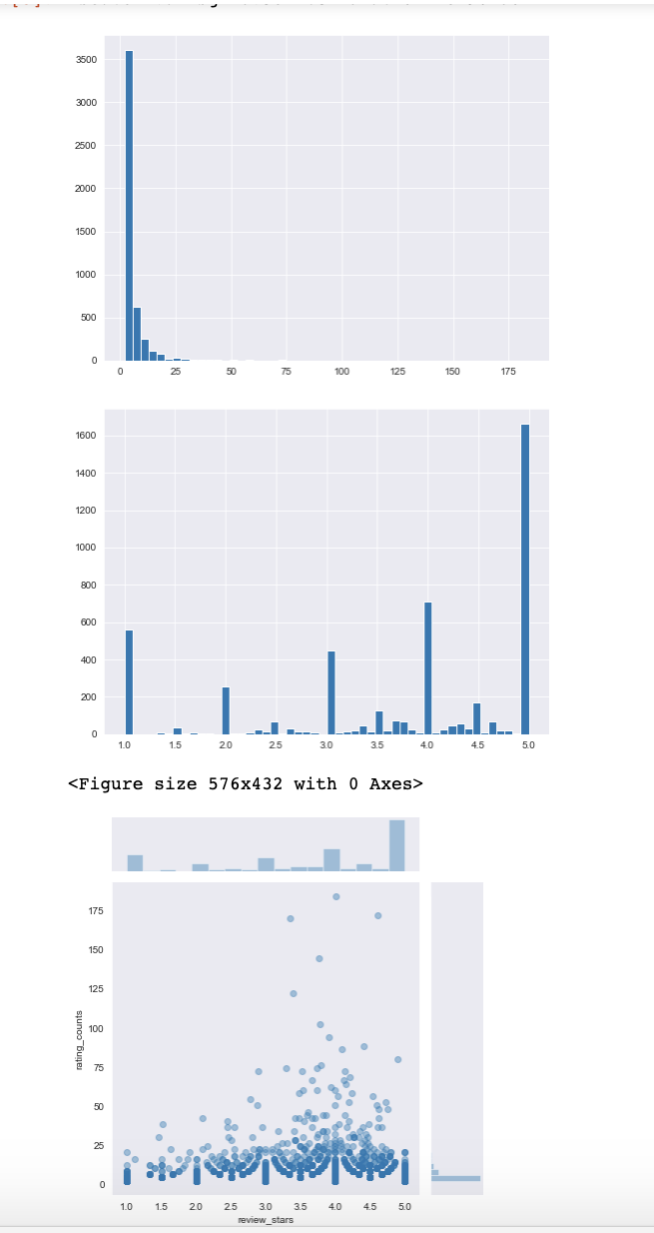
Rating Counts
Review Counts
Review_Stars versus Review Counts

Slide 11
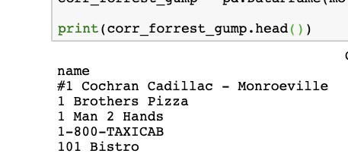
Using a Collaborative filtering technique:
If a user whent to
Rio Mirage Cafe Y Cantina,
Restaurants recommended
There still needs work for data cleaning, as we want a restaurant but we are being recommended a taxi service and a car dealership

Slide 12
Tools:
We will utilize:
Github
Discord
Google Cloud Bucket
Python
Google Docs
Overleaf (Writing final report)

